Slide 1
Introduction to Tableau
Part 4
Notes:
Welcome back to Data Society! We have a great class ahead of us today.

Slide 2
Module completion checklist
Objective | Complete
Manually join tables using joins
Introduce the concept of aggregating, binning, and grouping
Create and use bins and groups
Explore filtering capabilities of Tableau

Slide 3
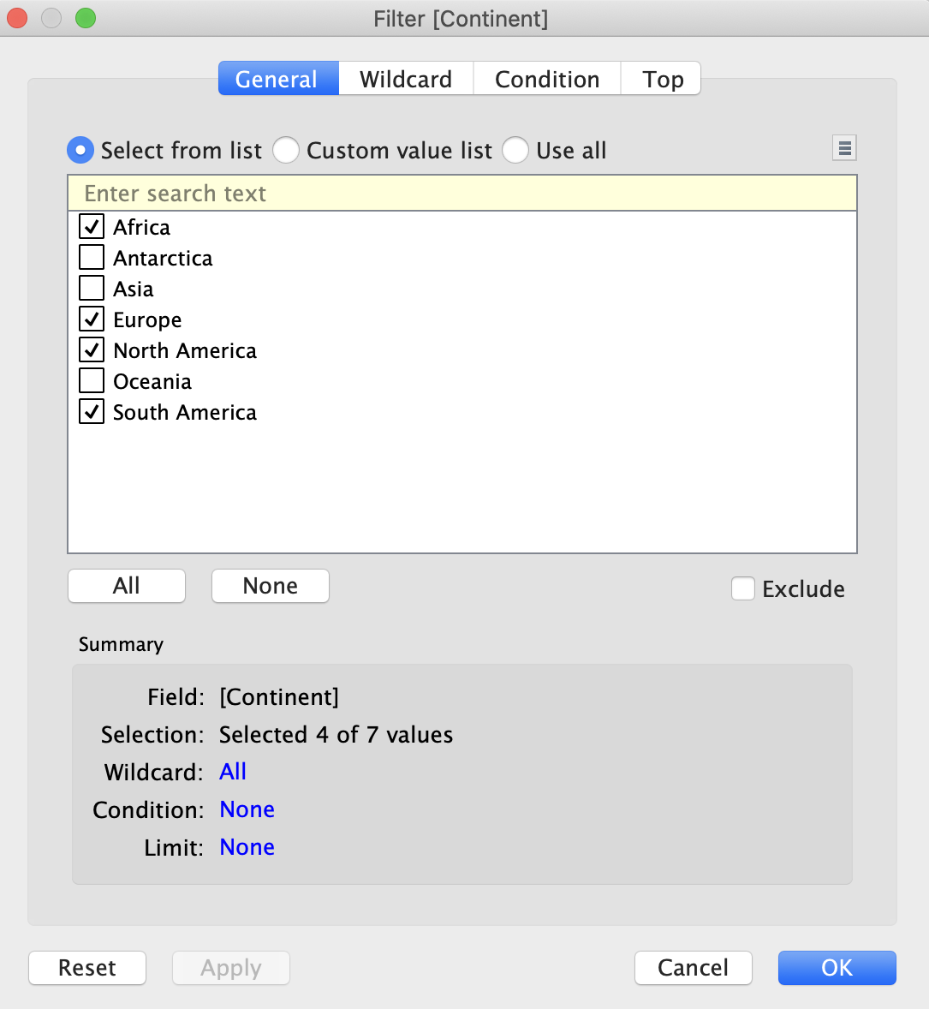
Cleaning and focusing: filters
It is often appropriate to graph only a portion of the data when:
There are credible outliers.
There are bad data such as input errors, null values or coded values.
i.e. missing values are often coded as integers and need to be filtered.
The question only addresses a certain interval.
i.e. “did the administration of a drug reduce mortality in the following month?”
Notes:
The purpose of this slide is to introduce the concept of filtering data in Tableau. It provides three overarching reasons why you might want to filter your dataset as part of the data cleaning process. EXPLAIN these reasons, then WALK THROUGH how to access the “Filter” menu on the slide.

Slide 4
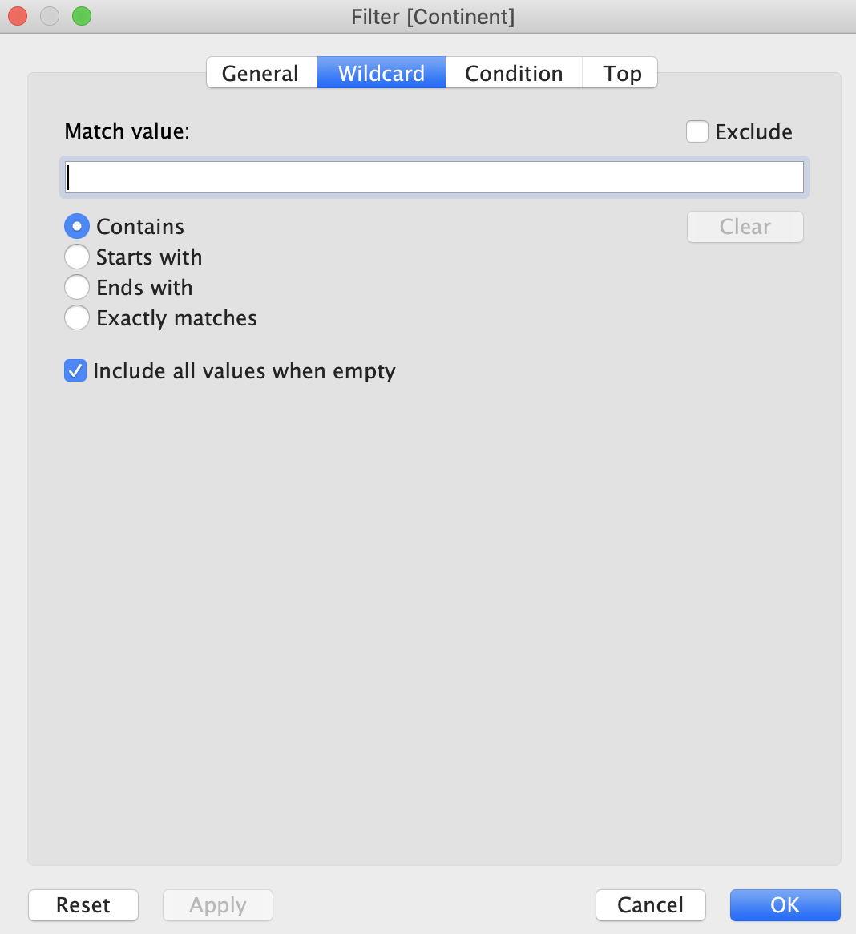
Filtering the world data: match value
We can use different type of filters to get more specific data.
Adding a match value will only include or exclude those columns that match that value.
Notes:
The purpose of this slide is to elaborate on filtering in Tableau by specifying a match value. DEFINE “match value” and DEMONSTRATE how it im

Slide 5
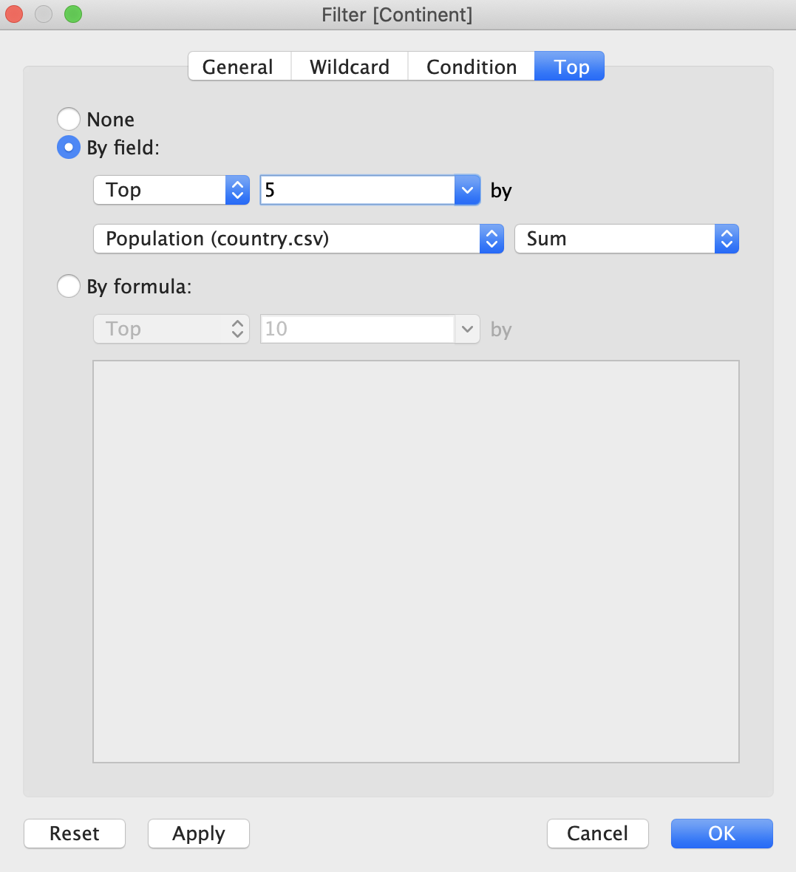
Filtering the world data: top values
If we want to display only top results we can use the Top option and enter the top number of values that we want to see returned.
Notes:
The purpose of this slide is to elaborate on filtering in Tableau by specifying a Top N number of values. DEFINE “top” and DEMONSTRATE how it impacts visualization.

Slide 6
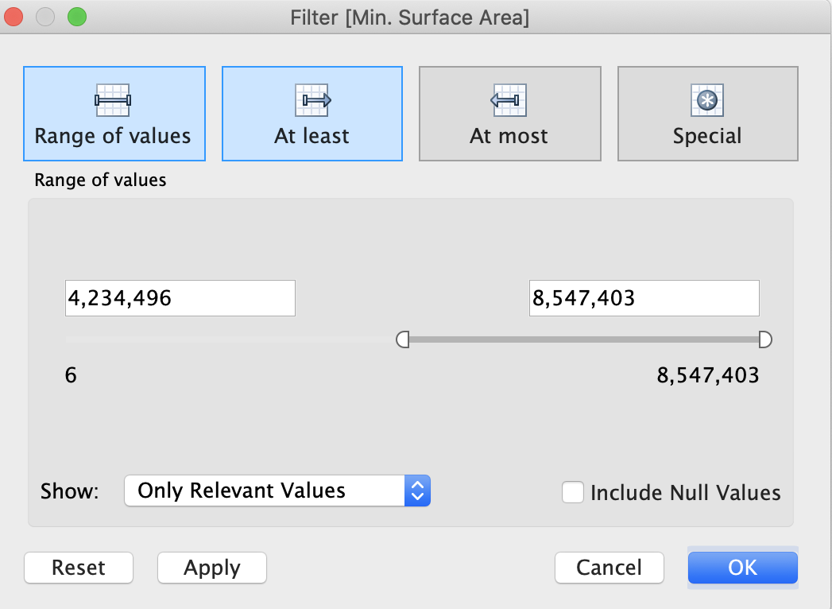
Filtering the world data: ranges
We can also use specific ranges to filter our data. This only works when our data is quantitative.
There are different ways of filtering by range.
We can also choose to filter out null values.
Notes:
The purpose of this slide is to elaborate on filtering in Tableau by specifying a range. DEFINE the different range options and DEMONSTRATE how they impacts visualization.

Slide 7
Knowledge check 4

Slide 8
Exercise 4

Slide 9
Module completion checklist
Objective | Complete
Manually join tables using joins
Introduce the concept of aggregating, binning, and grouping
Create and use bins and groups
Explore filtering capabilities of Tableau

Slide 10
Congratulations!
In the past few modules, we covered:
Aggregating by formula
Sorting
Attributes
Binning continuous data
Grouping by category
Cleaning and focusing with filters
Match value
Top values
Ranges
Notes:
The purpose of this slide is to review the various topics covered in class today. It is also an opportunity to ASK if students have any outstanding questions that need to be resolved.

Slide 11
Next Steps
In the next few modules, we will cover:
Formatting options.
Functions in Tableau.
Until then, stay excited!
Notes:
The purpose of this slide is to introduce the agenda for the next session. COMMENT briefly on each topic to set expectations and encourage prediction.

Slide 12
End of Part 4

